Slide 1

MSiA 423 Mid-project Review: Movie Recommender
By: Sabarish Chockalingam

Slide 2
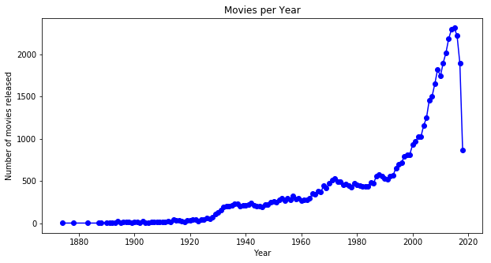
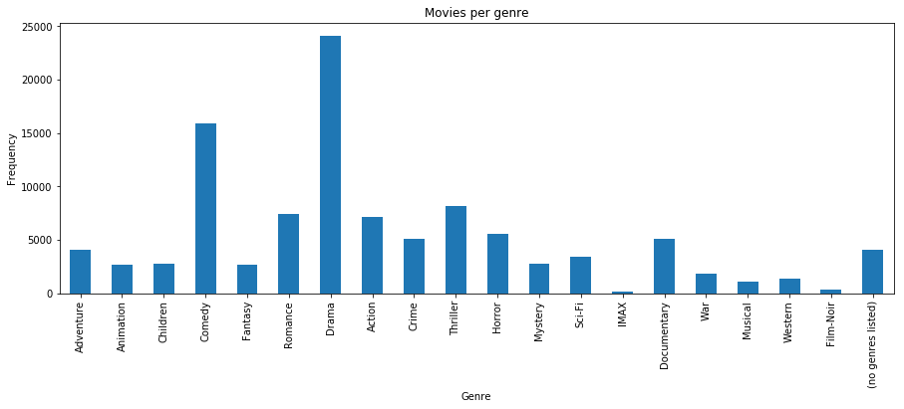
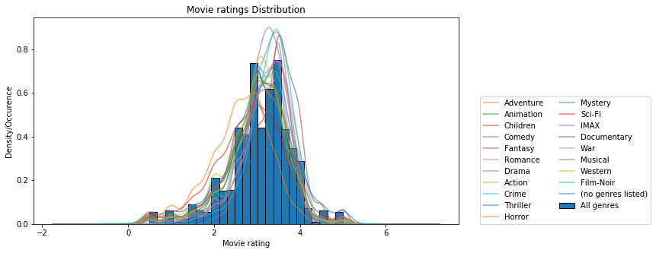
Highlights
Interesting fact: Ratings only started coming in from about 1997 (when movie lens started).
Below are visualization that helped with EDA and will aid when modelling.

Slide 3
Review progress
Imported Data and perform EDA. (2 pt)
Stored data set in S3. (1 pt)

Slide 4
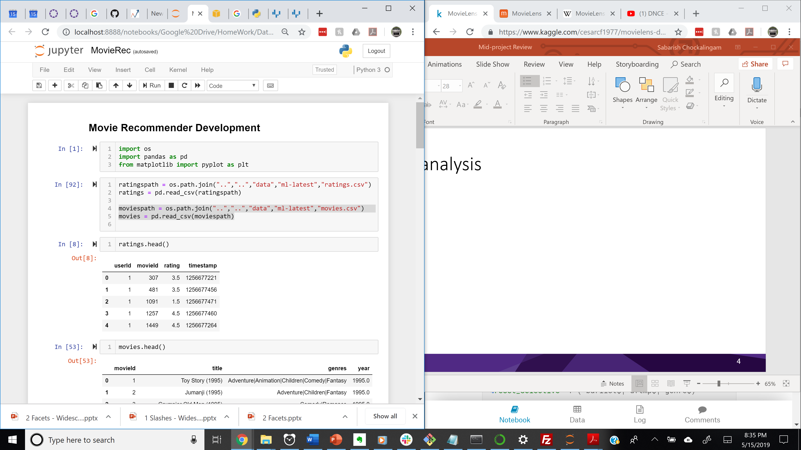
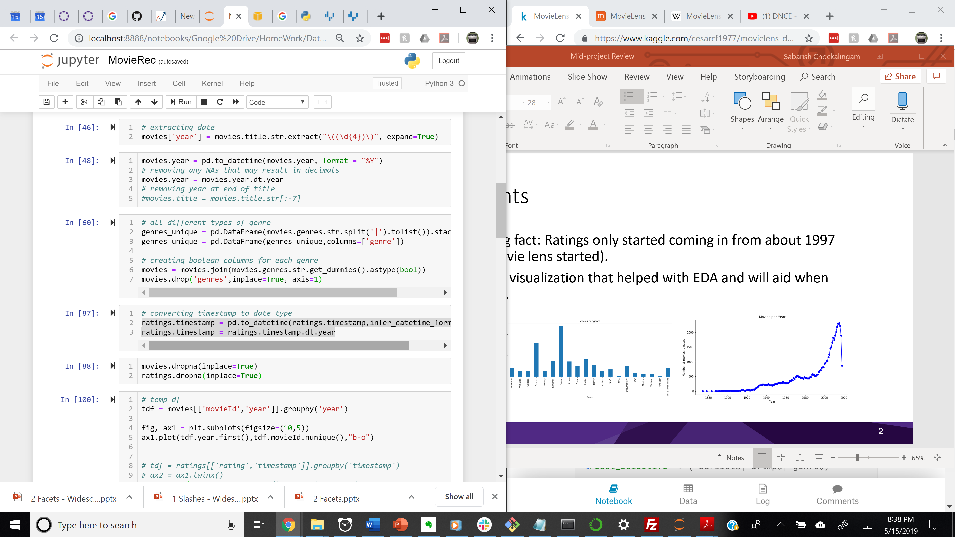
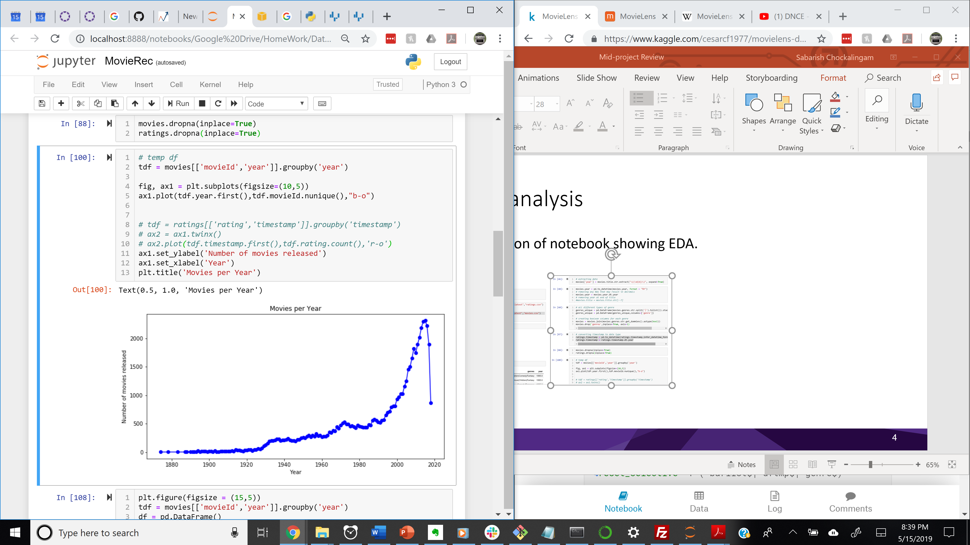
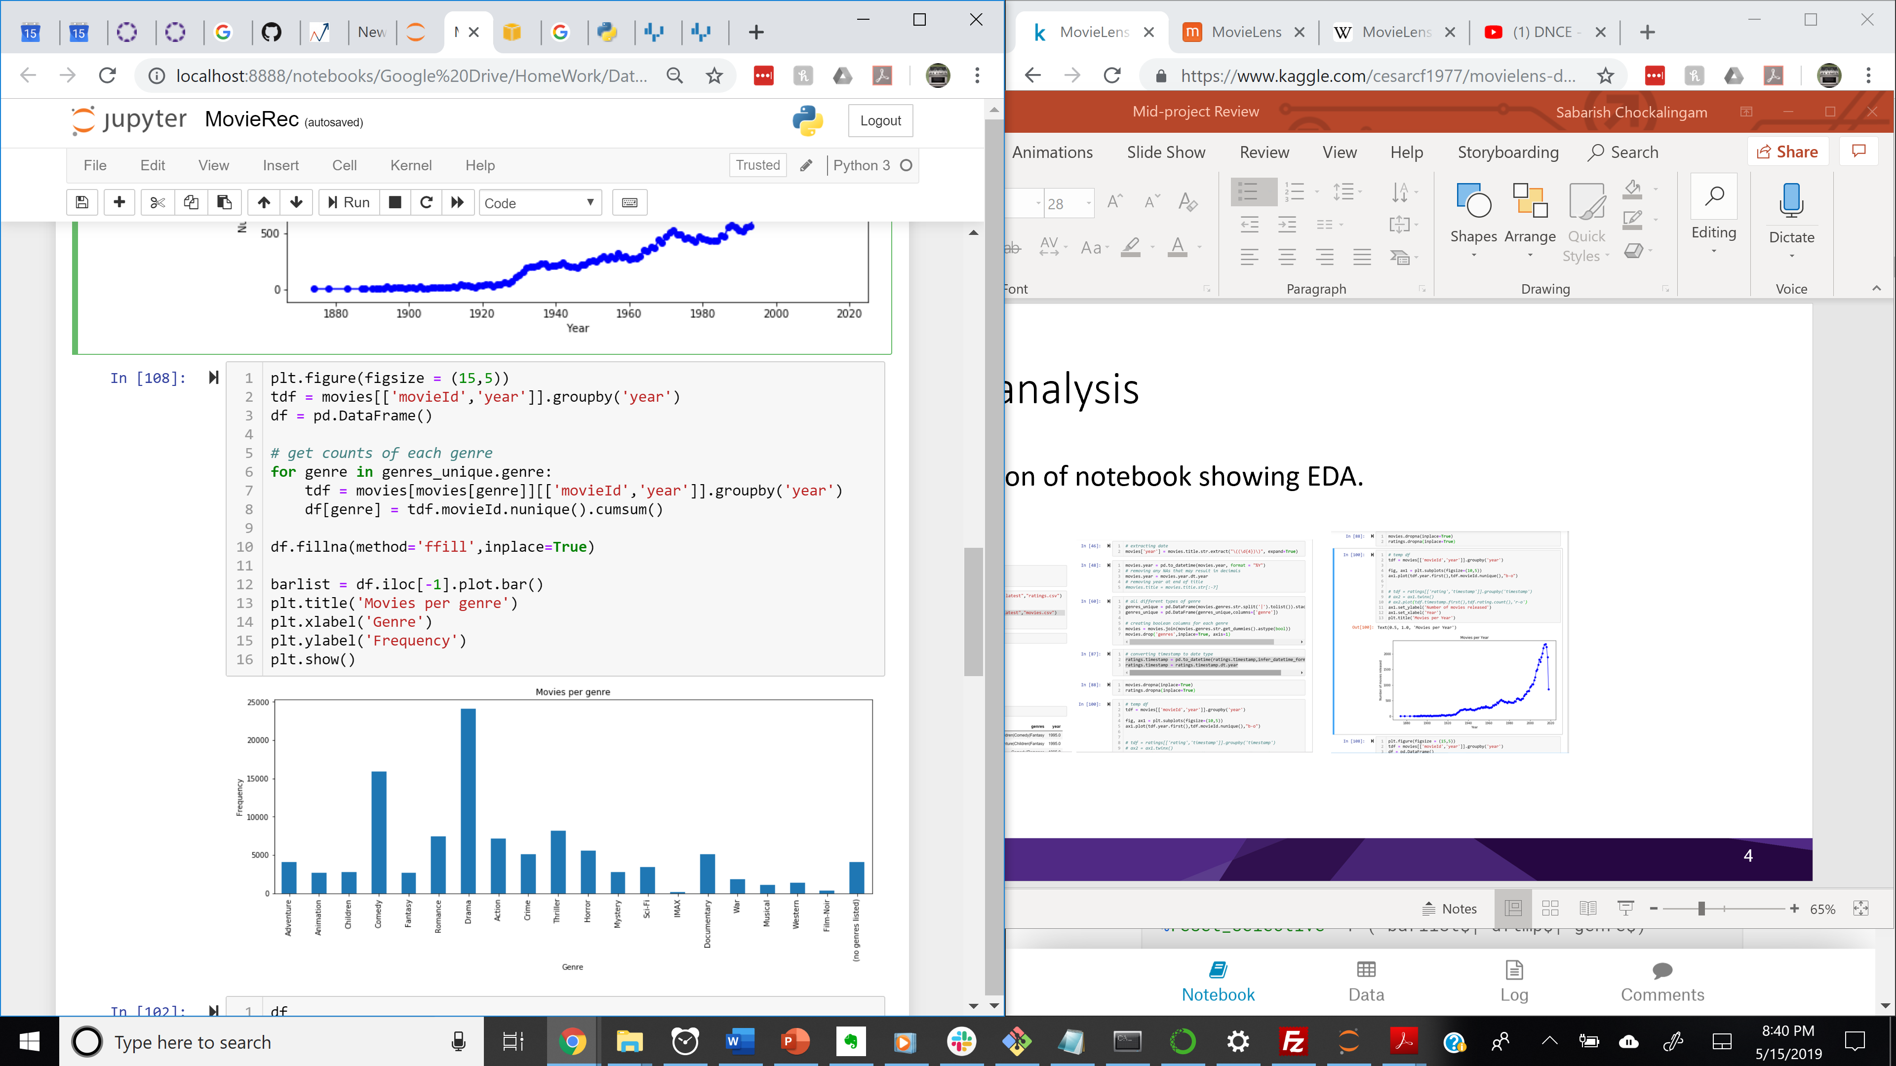
Demo/analysis
Visualization of notebook showing EDA.

Slide 5
Lessons learned
Recommender may not be as easy to evaluate as previously expected since 5 point rating system is not very accurate. For example, it is hard to distinguish top 5 movies for users who rate most movies 5 stars.
Planning to do the following to improve speed of recommender:
Ask user to pick genre.
Limit data to be from 1985 to present.

Slide 6
Recommendations
The following stories are essential for the core app and should be completed next.
Create Train and Test Data set. (0 pt)
Build and Train Model. (2 pt)
Create User Input Boxes (Movie Name and their Rating). (1 pt)
Match Input to Movie in Dataset. (1 pt)
Autocomplete Title Input. (1 pt)
Returns top 5 recommendations from model. (1 pt)
Story 1: Deploy app via Flask (AWS). (4 pts)
After completion of these stories, most of the other stories involve tuning the model and improving the app.

